Slide 1
Summer Internship Presentation
Name-Lanka Aravind
Roll no-21027136
Programme-CSE
Semester-VII
Batch:2021-2025

Slide 2
INTRODUCTION
Name of Organization : ZIDIO DEVELOPMENT
Role : Data Science and Analytics Intern
Type : Internship
Mentor : Chandan Mishra
Duration : 2 months

Slide 3
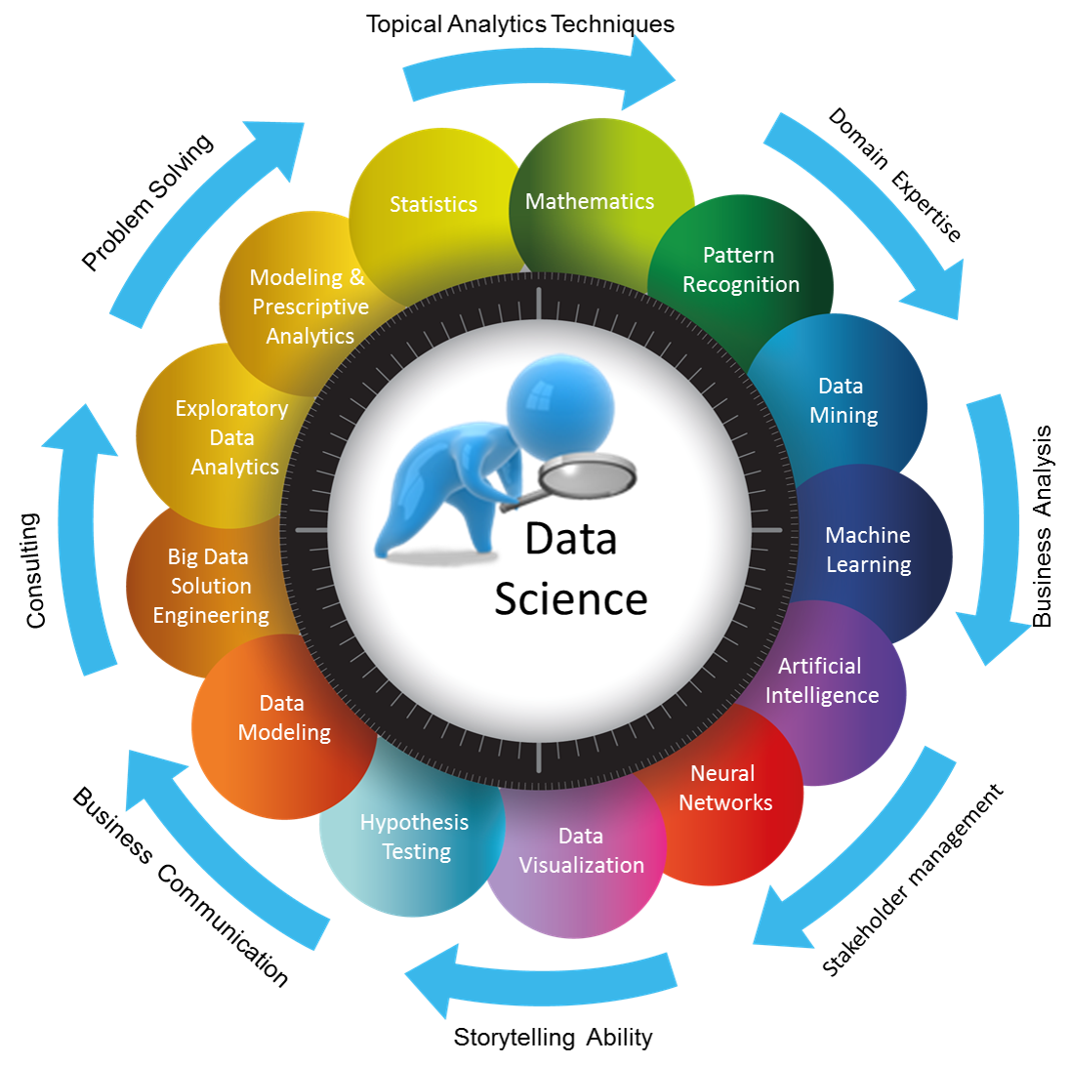
Introduction to Data Science
What is Data Science?
Data science is a multidisciplinary field that uses statistical and computational methods to extract insights and knowledge from data.
Data Science is kinda blended with various tools, algorithms, and machine learning principles.

Slide 4
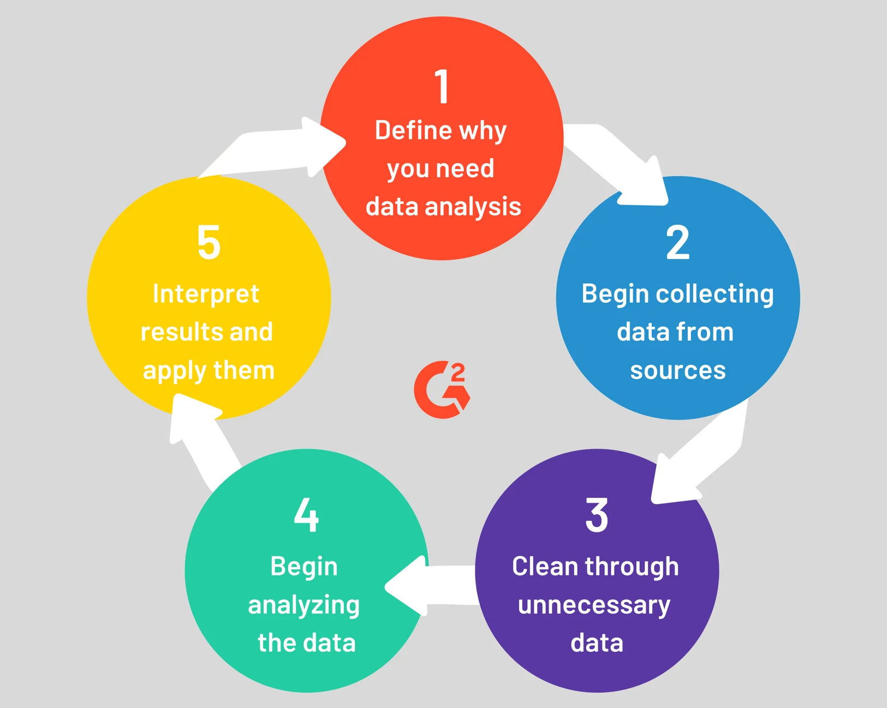
Introduction to Data Analytics
Data analytics is the process of analyzing raw data in order to draw out meaningful, actionable insights, which are then used to inform and drive smart business decisions.

Slide 5
OBJECTIVE
The Presentation is Mainly focus on showcasing my internship journey and my learnings in the organization.
It describes my learnings and responsibilities undertaken.
Main role that I have undergone during the internship is creating beautiful dashboards according to the vendors and clients requirements.
Some of the tasks I involved are displayed here are::

Slide 6
Tasks During Internship
Created A visual Dashboard of employees and their complete info working in the organisation.
By using Toronto Dataset worked on Speech emotion recognition Project.
Worked on Creating a visual representation of Famous Ecommerce Site BLINKIT on various analysis.

Slide 7
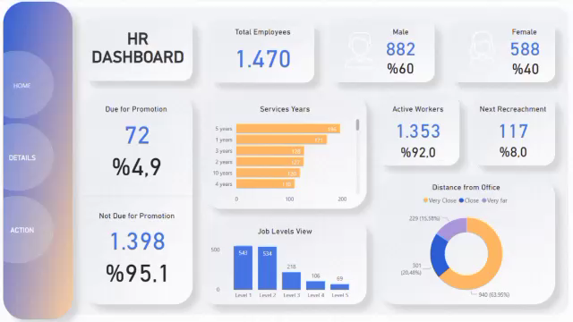
Created A visual Dashboard of employees and their complete info working in the organisation.
Using the data from HR Department Created a visual representation of the Data of employees worked in the organization.
It involves data collection, cleaning, analyzing the data and apply the techniques.

Slide 8
Role of MS-Excel in HR Dashboard Creation
Data Collection: Import and organize HR data in Excel (e.g., employee info, performance, payroll).
Data Cleaning: Clean and prepare the data (e.g., remove duplicates, handle missing values).
Data Analysis: Use formulas, pivot tables, and charts to analyze key HR metrics.
Data Visualization: Create charts, graphs, and apply conditional formatting to highlight important insights.
Dashboard Creation: Combine charts and tables into a single sheet to create an interactive HR dashboard.
Reporting: Automate report generation and share the dashboard in various formats (e.g., PDF, Excel).

Slide 9
Tools : Tableau, M s-Excel.
Git hub Link : https://github.com/Aravind1727/HR-Dasboard-Craetion.git
As a part of group we divide the work and created a dashboard.
Duration of Project : 4 days
By taking instructions from the mentor the project is created Successfully.

Slide 10

2. By using Toronto Dataset worked on Speech emotion recognition Project.
1. Understand the Dataset
Dataset Overview: The Toronto Emotional Speech Set (TESS) contains r r recordings of two actresses speaking a set of 200 target words in the neutral, happy, sad, angry, fearful, disgusted, and surprised emotions.

Slide 11
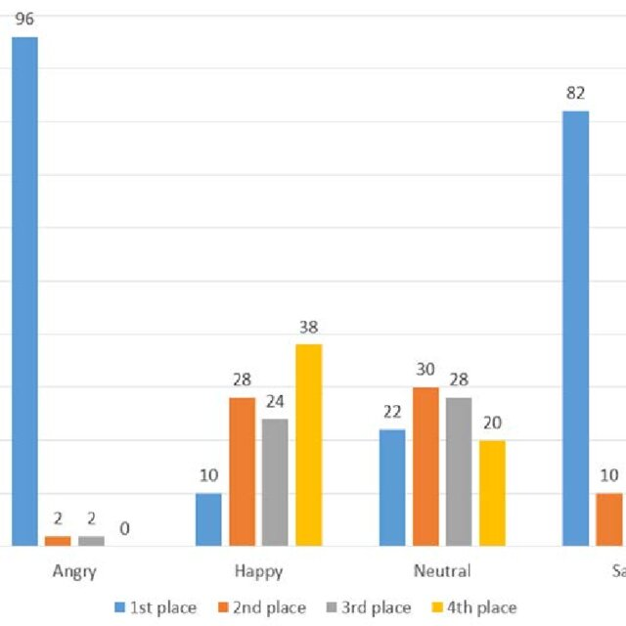
2. Data Preprocessing
Loading the Data: Load the audio files using libraries like librosa or wave.
Noise Reduction: Apply noise reduction techniques if necessary, using methods like spectral gating.
3. As a part of the group we created this projected and completed it with as per instructions given by guide.
4. Duration : It is ongoing Currently .
By using Google Colab done this work using python and Machine Learning algorithms.
Analysis of different emotions

Slide 12
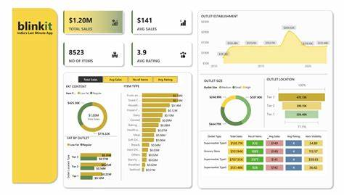
3. Worked on Creating a visual representation of Famous Ecommerce Site BLINKIT on various analysis.
Created a visual representation of the Different scenarios about BLINKIT Group.
It involves the location of group and many more.
The most excited from remaining projects and from these one is used advance topics like Map and manymore.
It involves data collection, cleaning, analyzing the data and apply the techniques.

Slide 13
Role of SQL in Blinkit Dashboard Creation
SQL plays a crucial role in data extraction, transformation, and loading (ETL). They are :
Understanding the Data Requirements
Data Sources: Identify the databases and tables in SQL that contain the relevant data (e.g., sales data, inventory, delivery times, customer data, etc.)
Key Metrics: Define the KPIs (Key Performance Indicators) you want to display on the dashboard (e.g., total sales, order fulfillment rates, average delivery time, etc.).
2. Data Extraction using SQL
Writing SQL Queries: SQL is used to extract data from various tables and databases.

Slide 14
3. Data Transformation
Data Cleaning: Use SQL to clean and prepare data.
4. Data Loading
Connecting SQL to Tableau:
Establish a connection between Tableau and your SQL database. Tableau supports various SQL databases like MySQL, PostgreSQL, SQL Server, etc.
Use Tableau's built-in SQL Editor or write custom SQL queries within Tableau to pull in the pre-processed data.
5. Building the Dashboard in Tableau
Data Import: Use the SQL queries or views to import data into Tableau.
Data Blending: If data from multiple sources (or SQL queries) needs to be combined, Tableau allows data blending to create a unified dataset.
Tools : Tableau, SQL, Data.
Duration : 6 days.
Githu Link : https://github.com/Aravind1727/Data-Analytics-Dashboard-Creation.git

Slide 15
Thank You

